Slide 1






WEB3 Assistant
Your Web3 guide Always by your side
AIBO
By Fred
31 March, 2024

Slide 2
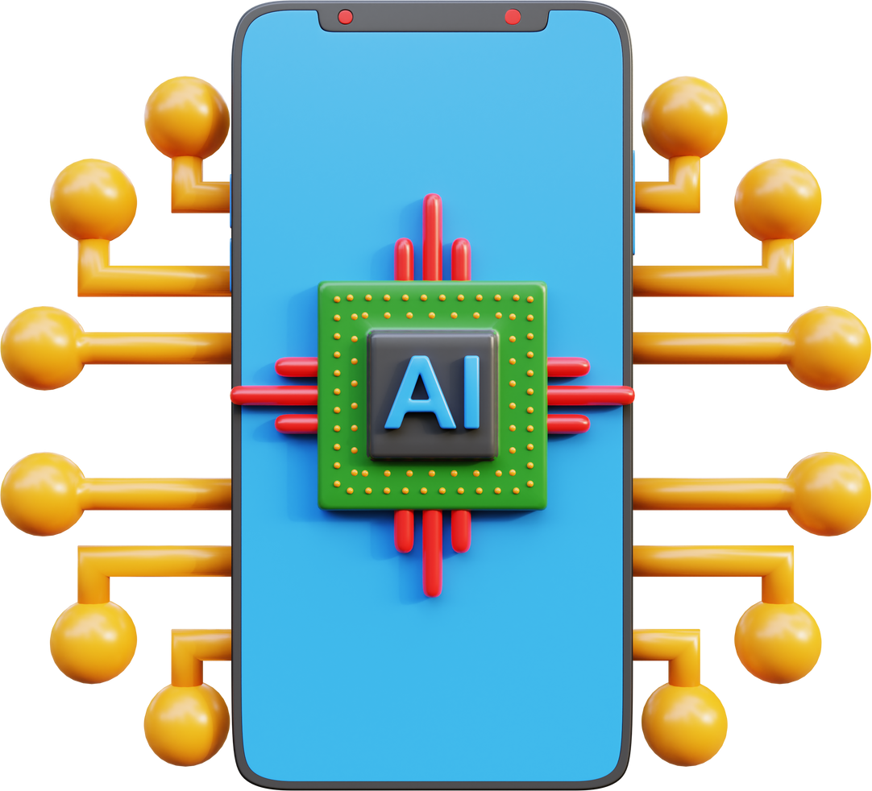
About AIBO
Privacy Defender
AIBO leverages end-to-end encryption technology to ensure your conversations remain private and secure. The security of your chat data is our top priority.
Blockchain Encyclopedia
Powered by cutting-edge AI technology, AIBO collects and analyzes trending topics and transaction data on the blockchain. This will empower you with unparalleled insights into the ever-evolving blockchain landscape.
Smart Trading Assistant
AIBO's intuitive and user-friendly interface makes it easy for anyone to get started, regardless of their experience or expertise. With AIBO, you can seamlessly access all the trading tools you need to make informed investment decisions, all in one place.

Slide 3

Technical Architecture
Matrix + Synapse
Enables decentralized and secure transmission of chat data and connects to multiple social apps, such as Telegram or Discord
Large-scale Language Model
Empower user intent analysis and dialogue management, store user memories, and generate personalized responses for users.
On-chain Aggregators
Identify optimal trading paths and provide users with the best trading services.

Slide 4



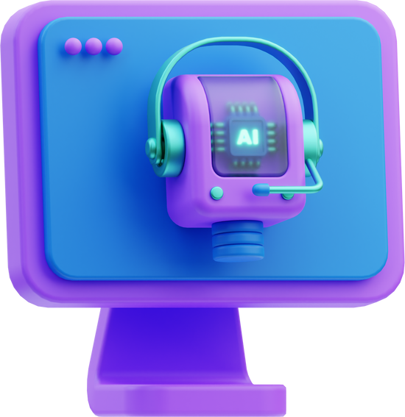
Business Loop
Customer acquisition
Utilize Web2 users' familiar chat tools, such as Telegram, as a medium for promotion.
Participate in Web3 community events to improve project awareness.
Customer retention
Cultivate user habits through AI chatbot features
Generate customized AIbots by continuously learning from chat content and user habits.
Customer conversion
Achieve user value conversion through in-chat transactions.
Provide a safe and reliable trading environment to ensure the security of user assets.

Slide 5





Coming Next...
01
02
03
04
Bot
Agent
Autonomous Agent
Autonomous Agent
Network

Slide 6



WEB3
Assistant
Thank You!
https://www.aibo.chat

